Slide 1

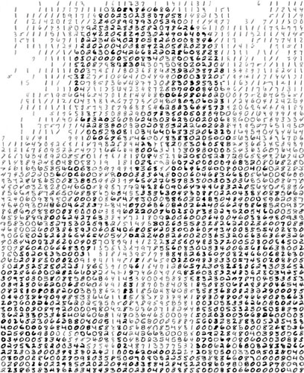
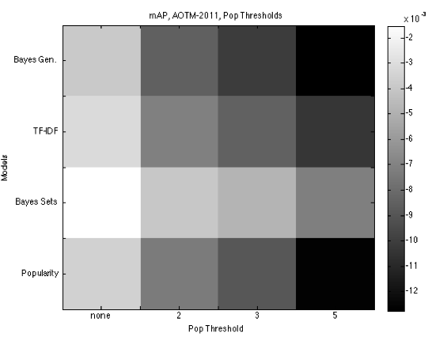
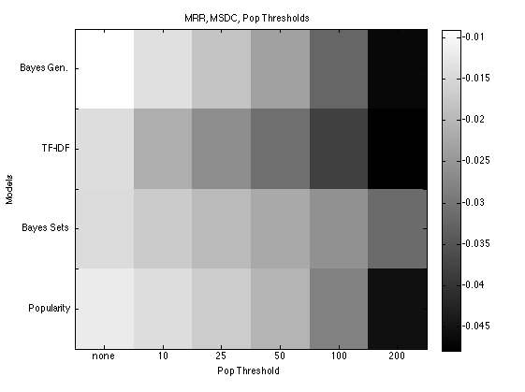
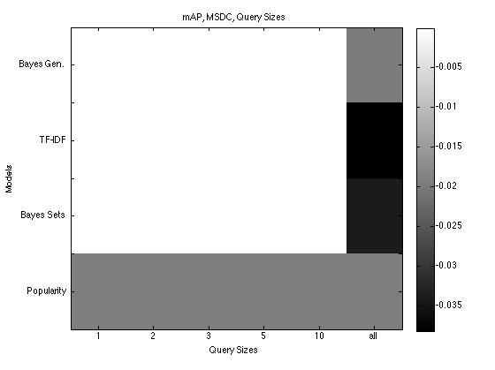
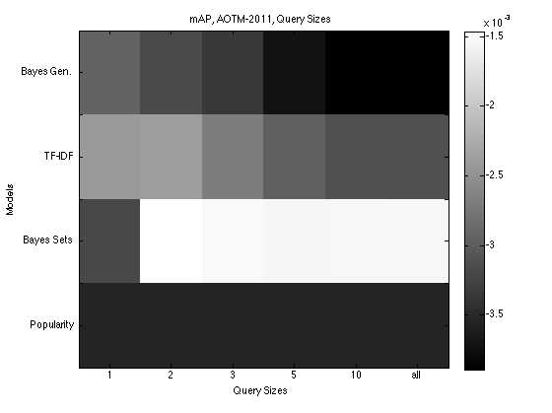
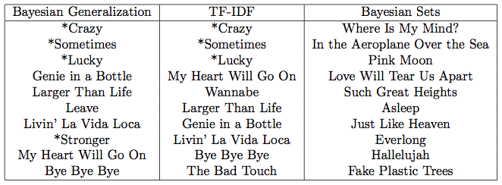
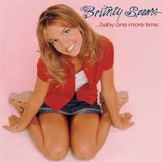

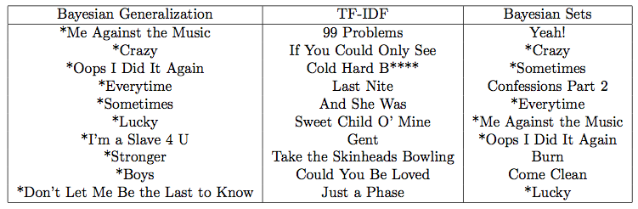

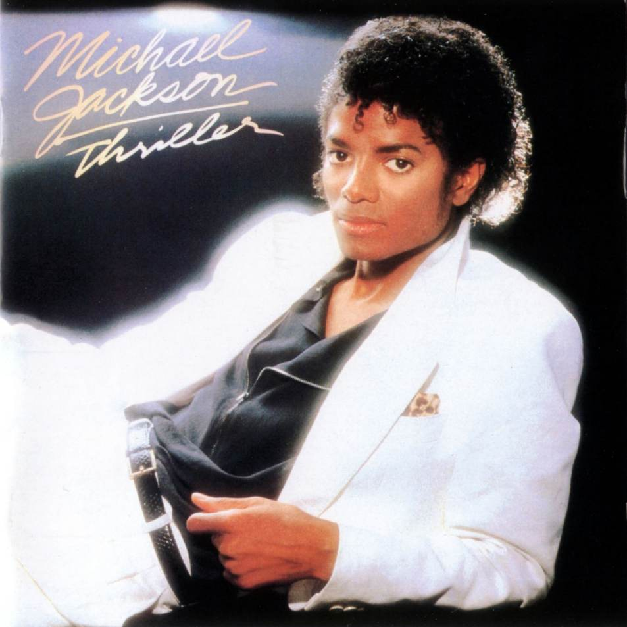


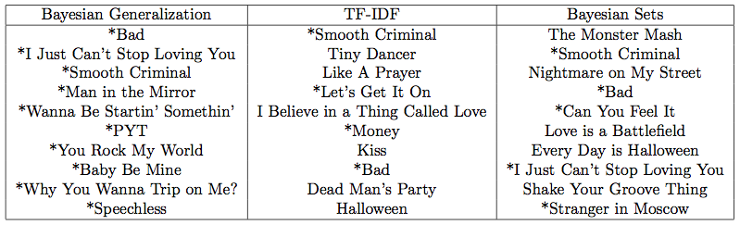
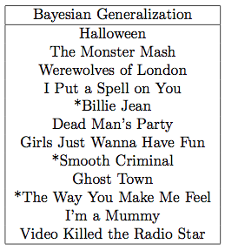
Applying Psychological Models of Generalization to Music Recommendation Systems
Tiffany Hwu Joshua Abbott Thomas Griffiths tiffanyhwu@berkeley.edu joshua.abbott@berkeley.edu tom_griffiths@berkeley.edu
Introduction
Methods
Results Pt. 2
In generalization, stimuli are defined within a psychological space, in which previously experienced stimuli are used to create generalizations about newly presented stimuli (Shepard 1987). Similarly, a person who is recommending songs will use their prior musical knowledge or intuitions to find songs of similar taste.
The main objective of this work is to evaluate the effectiveness of applying psychological models to large -scale online datasets which contain the listening histories of users.
Datasets: Million Song Dataset, Art of the Mix 2011 dataset
Split datasets into test and train binary matrices
Constructing a Hypothesis Space
Metrics
Mean Average Precision (mAP)
Discounted Cumulative Gain (DCG)
Mean Reciprocal Rank (MRR)
Precision at 10 (P at 10)
mAP by Popularity Threshold
h1 h2 h3 h4 h5 h6
Psychological Models | Traditional Models
Bayesian Generalization | TF-IDF
Prototype | Bayesian Sets
Exemplar | Popularity
Songs
s1
s2
s3
s4
s5
s6
1 0 0 0 1 1 | 0 0 0 1 0 0 | 1 1 0 0 0 0 | 0 0 1 0 1 0 | 0 0 0 0 0 1 | 1 0 1 1 1 0
Evaluation Conditions
Popularity Threshold
Query Size
Qualitative Review
For both MSD and AOTM-2011 datasets, performance increases as popularity threshold increases. Bayesian generalization performs better on the AOTM-2011 and TF-IDF performs better on the MSD.
Background
Applying the Bayesian Framework of Generalization (Tenenbaum & Griffiths 2001)
The Bayesian generalization framework has been successfully used in a variety of different domains, and consists of the following parts:
Hypothesis space of positively seen examples
Ex. Playlists created by users
Prior – Erlang distribution
Intermediate size playlists are more informative
Likelihood – size principle
Smaller playlists more focused than larger playlists, given the prior
Bayes Rule
Probability of generalization
Sample input and output
X={‘Baby One More Time, Womanizer, Toxic’}
Y={‘Me Against the Music’, ‘Crazy’,’Oops I Did It Again’…}
Results
mAP by Query Size
X={‘Baby One More Time’}
As query size increases, mAP scores generally increase.
The MSD does not perform well for any of the query sizes
except for ‘all’.
X={‘Baby One More Time’, ‘Womanizer’, ‘Toxic’}
Discussion
Differences of results in the MSD and AOTM-2011 datasets might be explained by the fact that AOTM-2011 was created from user-selected playlists while the MSD contained entire listening histories.
We have seen that applying psychological models of generalization can contribute significantly to current systems and perhaps provide more insight into how a human would recommend songs versus how a typical machine learning algorithm would recommend songs.
References:
Shepard, R. N. (1987). Towards a universal law of generalization for psychological science. Science, 237, 1317-1323.
Tenenbaum, J., & Griffiths, T. L. (2001). Generalization, similarity, and Bayesian inference. Behavioral and Brain Sciences, 24, 629-641.
We see that Bayesian Generalization is good at discriminating between artist and genre, depending on the size of query.
For Michael Jackson songs, Bayesian Generalization recommends MJ songs if we provide 3 MJ songs in the query, and a mix of Halloween and MJ songs if we just provide ‘Thriller’.
X={‘Thriller’,’Billie Jean’,’The Way You Make Me Feel’}
X={‘Thriller’}

